Slide 1
Developing in SharePoint’s Middle Tier

Slide 2
Who Is Marc?
Marc is the Co-Founder and President of Sympraxis Consulting LLC, located in the Boston suburb of Newton, MA, USA. Sympraxis focuses on enabling collaboration throughout the enterprise using the SharePoint application platform.
He has almost 30 years of experience in technology professional services and software development. Over a wide-ranging career in consulting as well as line manager positions, Marc has proven himself as a problem solver and leader who can solve difficult technology problems for organizations across a wide variety of industries and organization sizes.
He was awarded the Microsoft MVP Award for SharePoint in January, 2011.

Slide 3
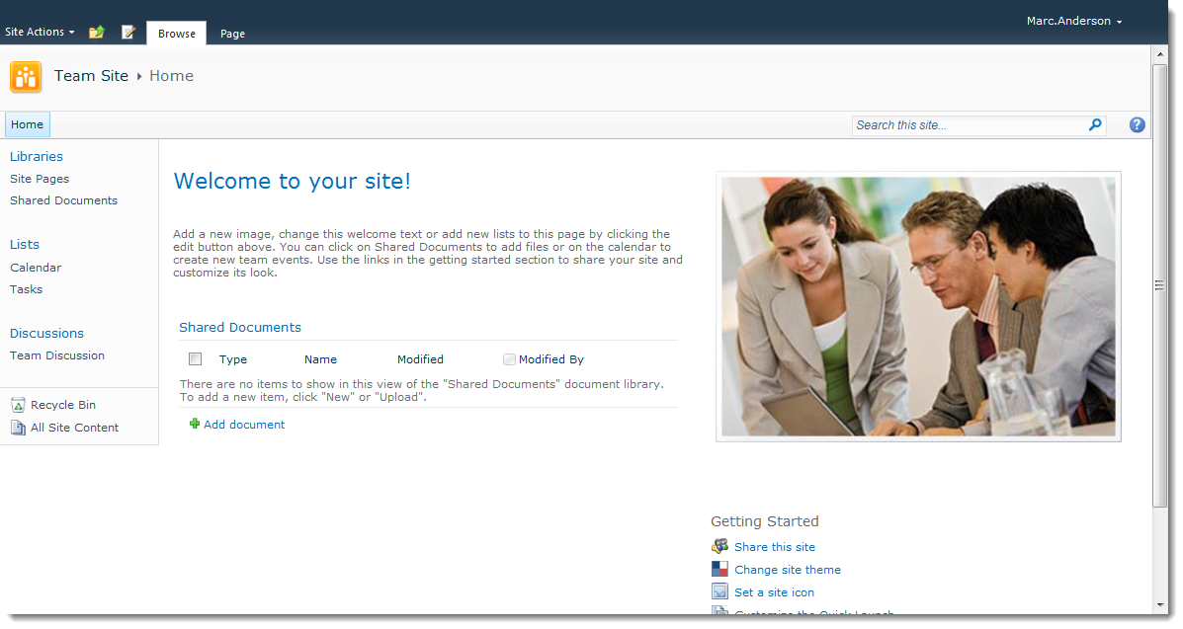
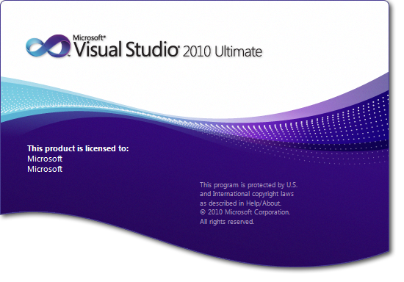
There Are Exactly Two Ways to Develop Solutions in SharePoint…Right?

Slide 4
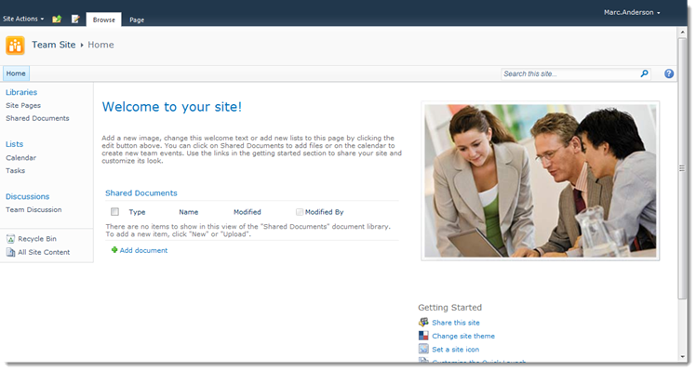
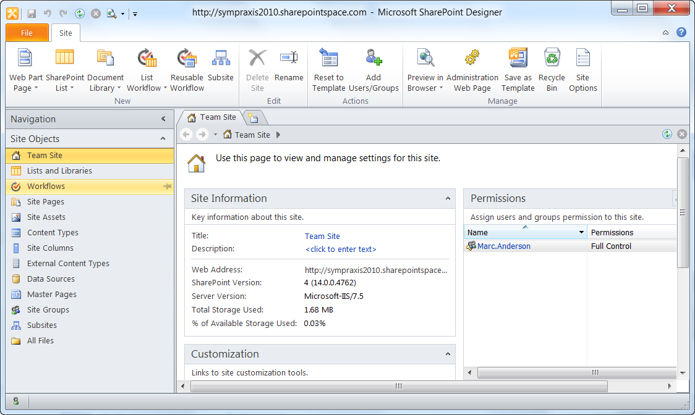
Wrong! There’s a Middle Ground…
…which I call “SharePoint’s Middle Tier”

Slide 5
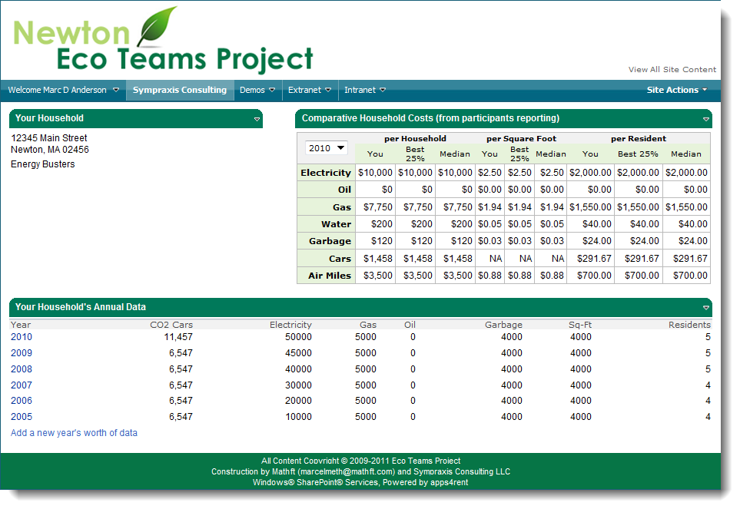
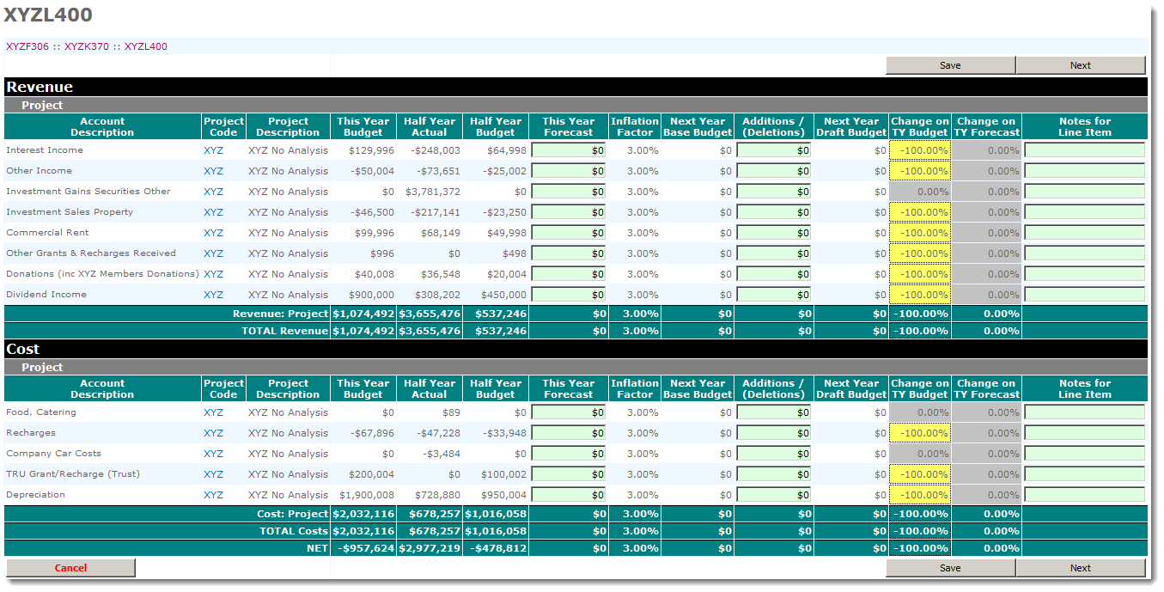
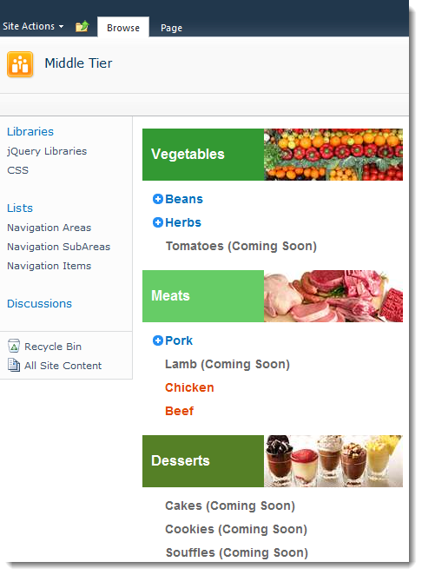
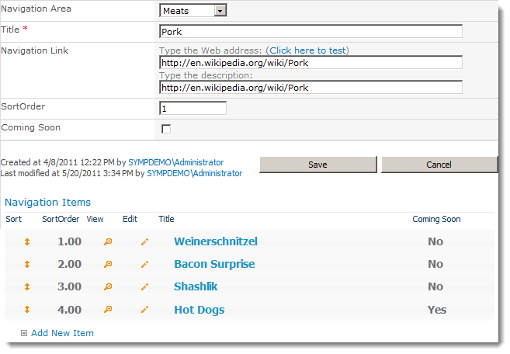
You Can Develop Real Solutions With Just SharePoint Designer
Dashboards
“Spreadsheets”
Real Multipage Applications
Richer Forms
Custom Navigation

Slide 6
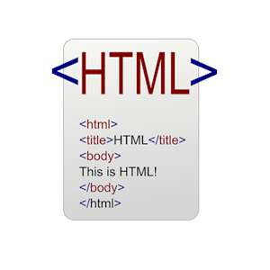
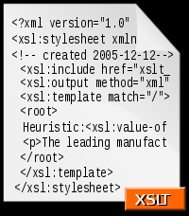
Using Common Web Development Tools…

Slide 7
…and Some Useful SharePoint-Specific Tools
Data View
Web Parts
(DVWPs)
Content Editor
Web Parts
(CEWPs)

Slide 8
Oh, and These Techniques Work Great in “The Cloud”

Slide 10
What Can’t You Do?
Event Receivers
Timer Jobs
Elevate Permissions
Deployments of a large number of sites or other objects

Slide 11
Don’t Forget Governance!
Development in the Middle Tier should also follow good governance
Coding practices
Deployment mechanisms
Testing methods
Documentation
Training
Maintenance planning

Slide 12
Demos

Slide 13
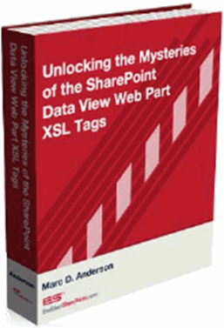
Contact Information
eMail | marc.anderson@sympraxisconsulting.com
Blog | http://sympmarc.com
SPServices | http://spservices.codeplex.com
SPXSLT | http://spxslt.codeplex.com
USPJA Academy | http://uspja.com
eBook | http://endusersharepoint.com
The Middle Tier Manifesto | http://bit.ly/middletier

Slide 14
Thank You for attending this session!
Please fill in the evaluation form

